Slide 1
PD06 • PORTFOLIO PROJECT
Target Dataset
Exploration
An SQL and Python Approach
“Navigating the Future of Online Shopping”
Suryansh Sinha
SQL • Pandas • Matplotlib • Google Colab
PD06 • Python + SQL Analysis
01

Slide 2
01 • CONTEXT
Project Overview
Objective
Workflow
Analyze and visualize business metrics using SQL and Python.
DATASETS
→
SQL
→
PYTHON
→
VISUALS
7 source files
15 problems
Pandas analysis
Matplotlib charts
Analysis scope
• Basic analysis
Deliverables
• Intermediate analysis
• SQL file with all three query levels
• Advanced analysis
• Colab notebook with Python visualizations
• Presentation summarizing project insights
PD06 • Python + SQL Analysis
02

Slide 3
02 • DATA
Dataset Overview
Customers
Orders
Order Items
Payments
99,441
99,441
112,650
103,886
Products
Sellers
Geolocation
32,951
3,095
1,000,163
7 source datasets • customer, order, product, payment, seller and geolocation data
PD06 • Python + SQL Analysis
03

Slide 4
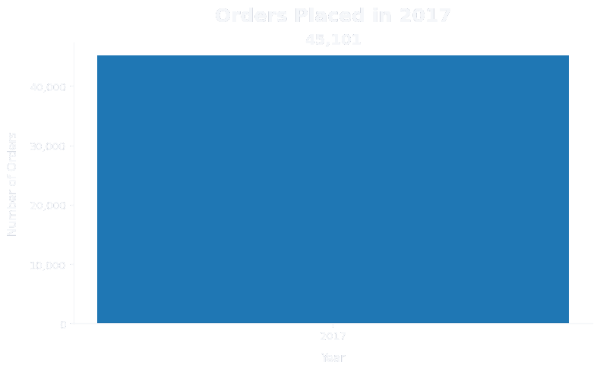
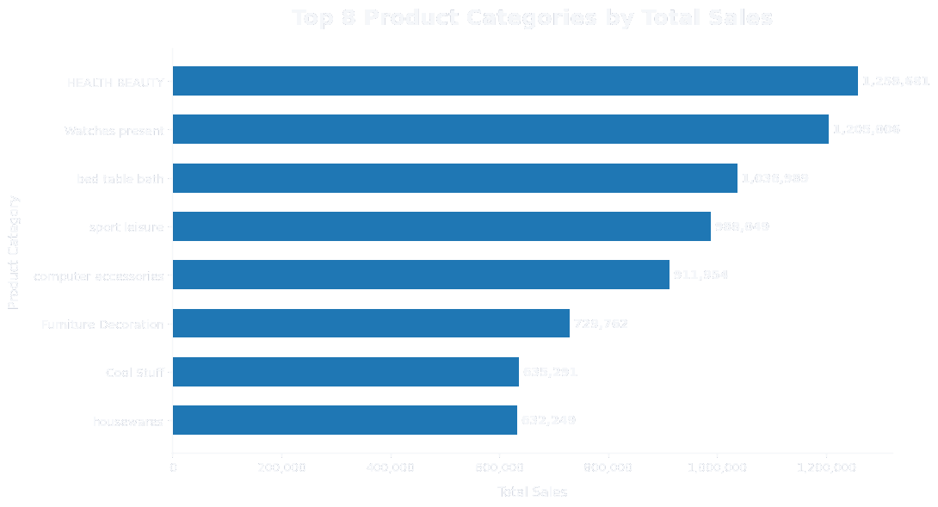
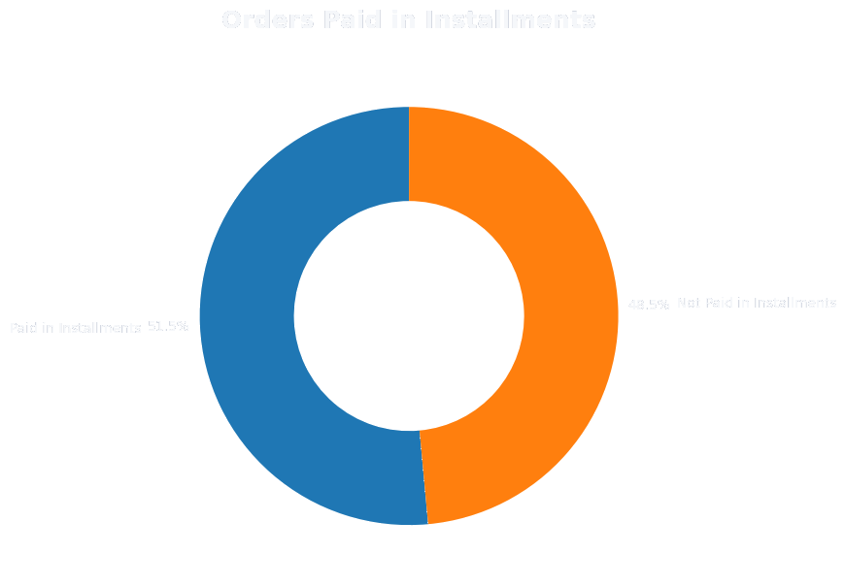
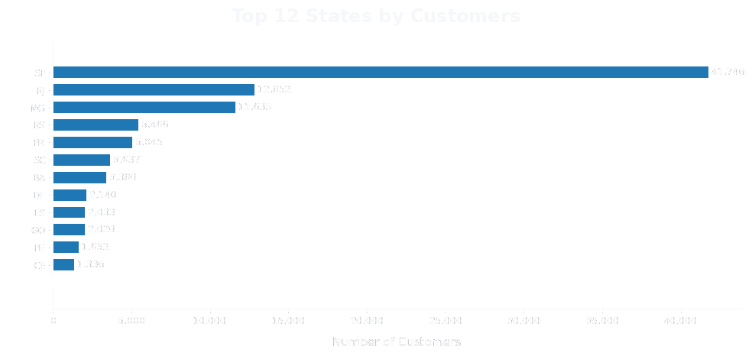
03 • FUNDAMENTALS
Basic Analysis
41,746 customers
in SP — largest state count
+15 more states — 6,499 customers
45,101 orders
Health & Beauty
51.46%
placed in 2017
₹1.26M top category sales
orders paid in installments
Basic-level result set
2017 recorded 45,101 orders. Health & Beauty generated the highest category sales at ₹1.26M. 51.46% of orders used installments, while SP accounted for 41,746 customers — the largest state count.
PD06 • Python + SQL Analysis
04

Slide 5
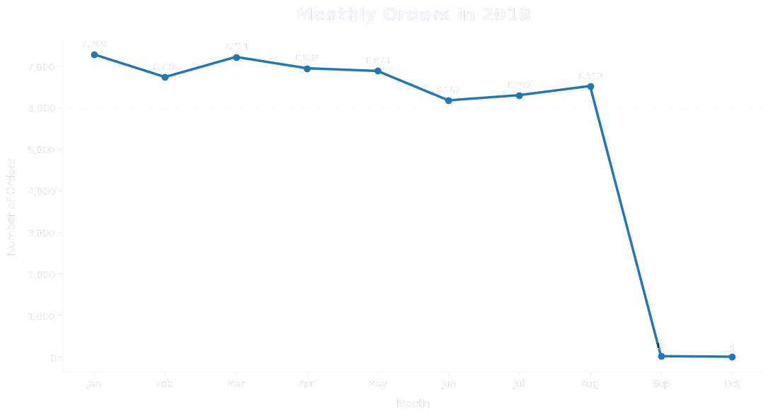
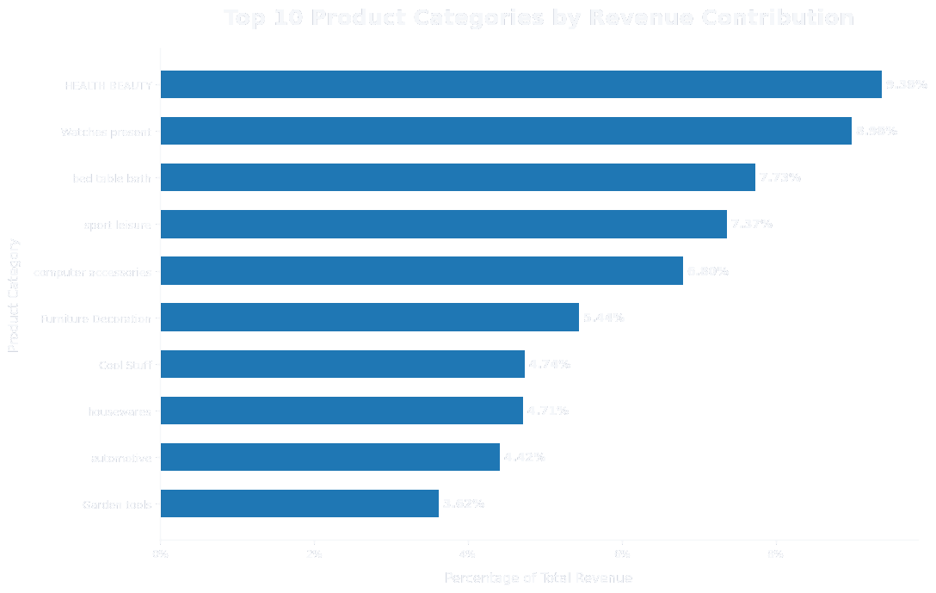
04 • INTERMEDIATE
Order & Revenue Trends
2018 orders
2018 order volume peaked in January at 7,269. September and October show only 16 and 4 orders respectively, creating a sharp drop at the end of the recorded 2018 series.
Category share
Health & Beauty contributed 9.38% of total category revenue, the highest share in the result set.
PD06 • Python + SQL Analysis
05

Slide 6
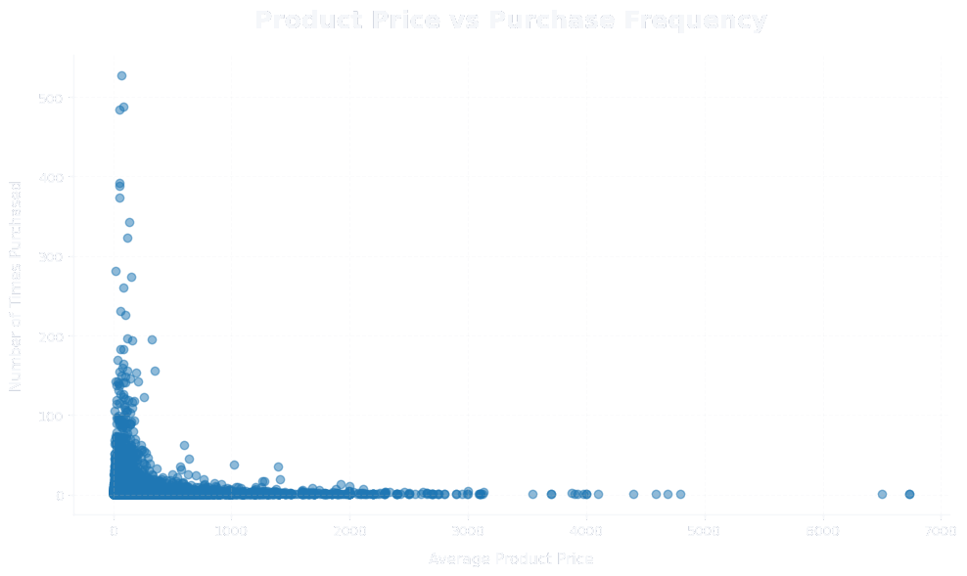
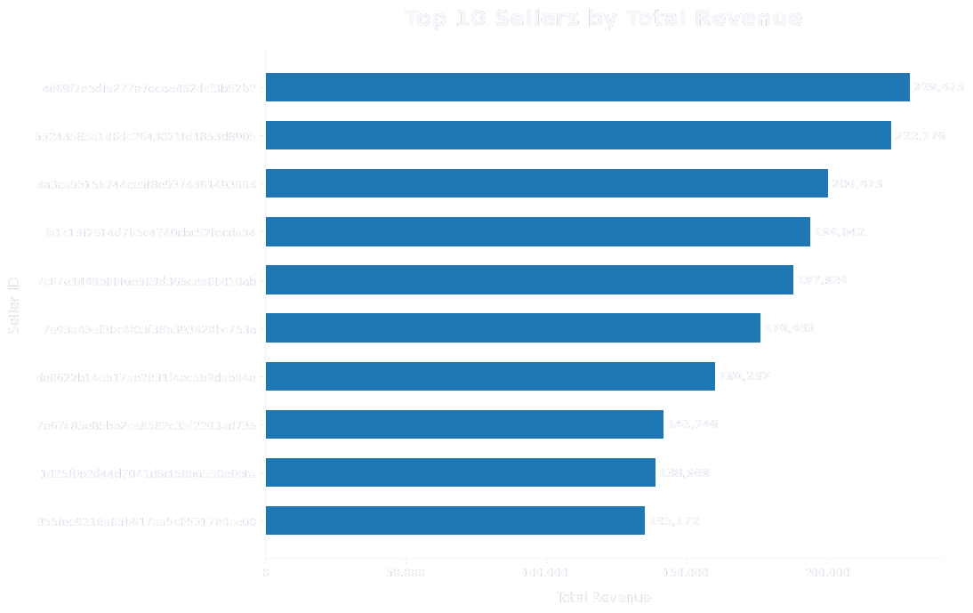
05 • INTERMEDIATE
Product & Seller Performance
Price vs purchase frequency correlation: −0.0321
This is a very weak negative relationship in the calculated product-level result.
Top seller revenue: ₹229,472.63
This is the highest seller revenue in the ranked seller result.
PD06 • Python + SQL Analysis
06

Slide 7
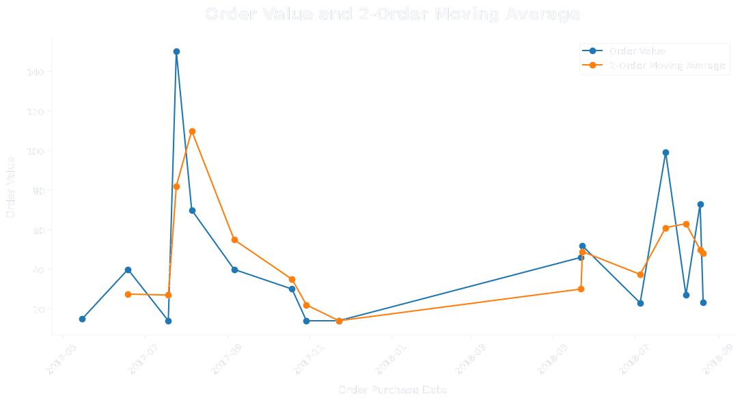
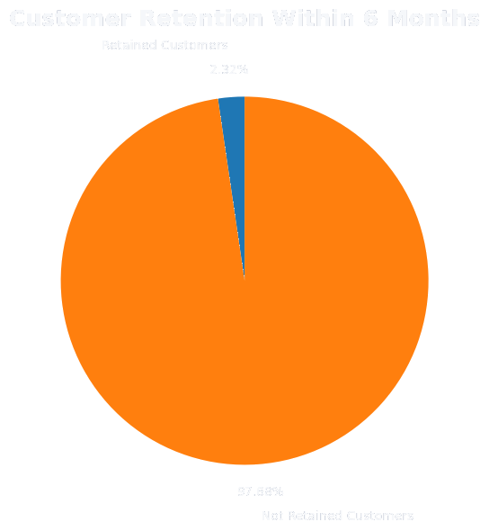
06 • ADVANCED
Customer Behaviour
6-Month Retention
2.32%
of customers made another purchase within 6 months of their first purchase.
The selected customer had 16 orders, allowing the 2-record moving average to show short-term changes in order value.
PD06 • Python + SQL Analysis
07

Slide 8
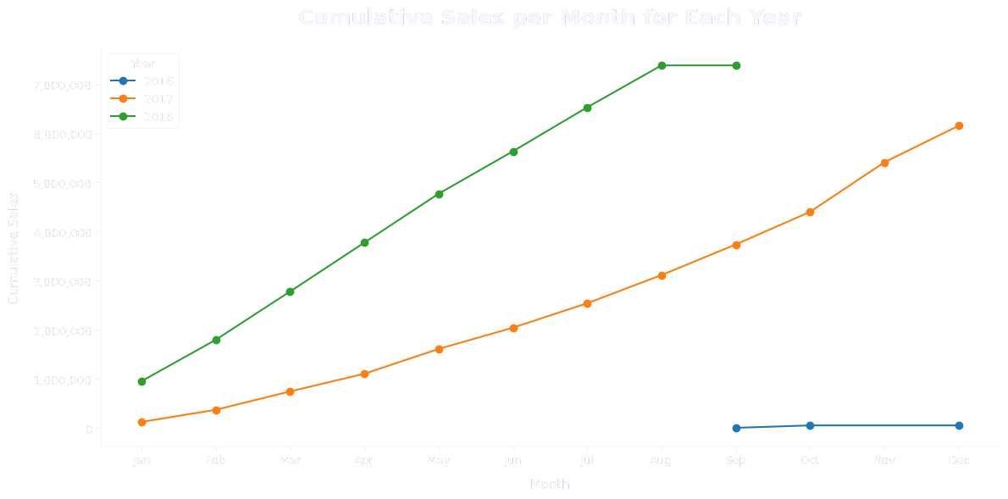
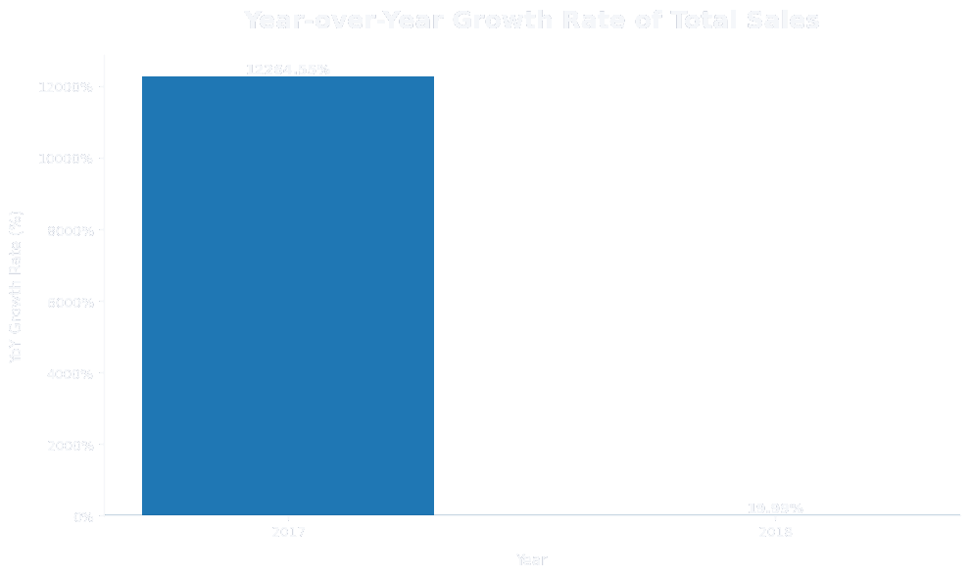
07 • ADVANCED
Sales Trends
Year-over-Year Growth
2018 total sales
₹7.39M
2018 YoY growth: 19.99% • 2017 growth is 12,264.55% because the 2016 base is small.
The 2018 rate is the more directly comparable annual change shown in the result.
PD06 • Python + SQL Analysis
08

Slide 9
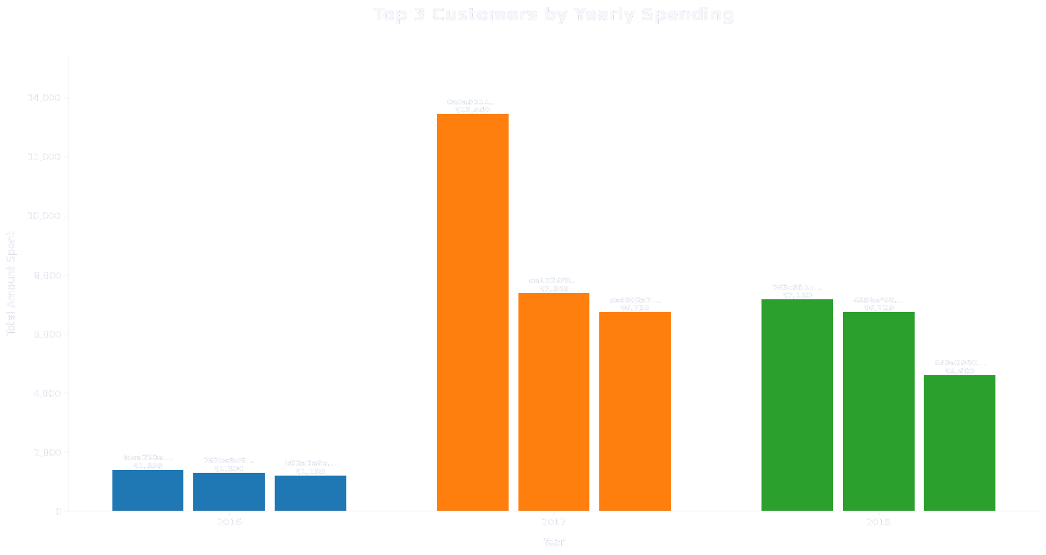
08 • ADVANCED
High-Value Customers
Ranking logic
• Yearly customer spend
• Top 3 per year
• Customer IDs shortened on chart
The yearly ranking identifies the three highest-spending customers separately for each year. Full customer IDs remain available in the underlying analysis.
PD06 • Python + SQL Analysis
09

Slide 10
09 • CLOSE
Key Results & Deliverables
Key results
Project deliverables
• 4,119 unique customer cities were identified.
• SQL analysis — Basic / Intermediate / Advanced
• 2017 recorded 45,101 orders.
• Google Colab Python visualizations
• 51.46% of orders were paid in installments.
• The highest category revenue share was 9.38%.
• Portfolio presentation
• Price vs purchase frequency correlation was −0.0321.
• 2018 total sales reached ₹7.39M with 19.99% YoY growth.
GitHub Repository
—
• 6-month customer retention rate was 2.32%.
Suryansh Sinha
PD06 • Python + SQL Analysis
10

